Slide 1

Project on National Data Portals in Samoa and Fiji Workshop 2 Experience Sharing and SDMX/.Stat Suite Tools 27-31 January 2025 Suva, Fiji
.Stat Suite: Excel Add-in

Slide 2


Learning objectives
At the end of this session, you will be able to use the SDMX .Stat Excel Add-in for:
Getting data and referential metadata
Editing data and referential metadata

Slide 3
Outline
Get (meta)data
Select
Specify output
Data content
Referential metadata content
Edit (meta)data
Updating
Editing strings and XHTML
Adding
Replacing
Deleting
Saving

Slide 4

Overview
Good to get/upload data
Great to edit metadata

Slide 5
Overview
The DLM Excel Add-in is packaged as a ClickOnce application and is deployed using the common procedure for deployment of ClickOnce applications.

Slide 6
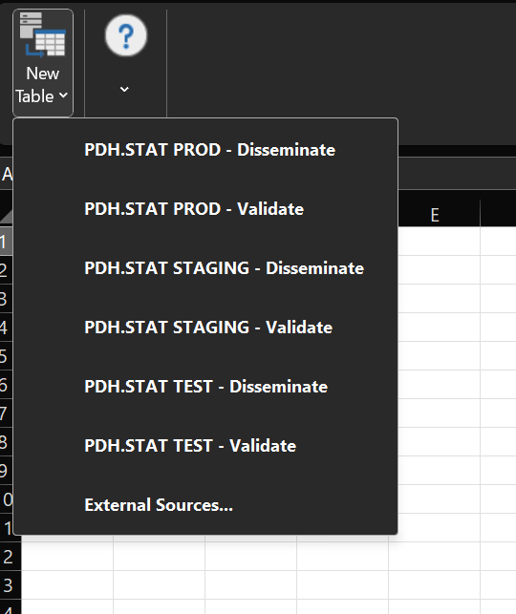
Get data: select
Step 1
Select Data space

Slide 7
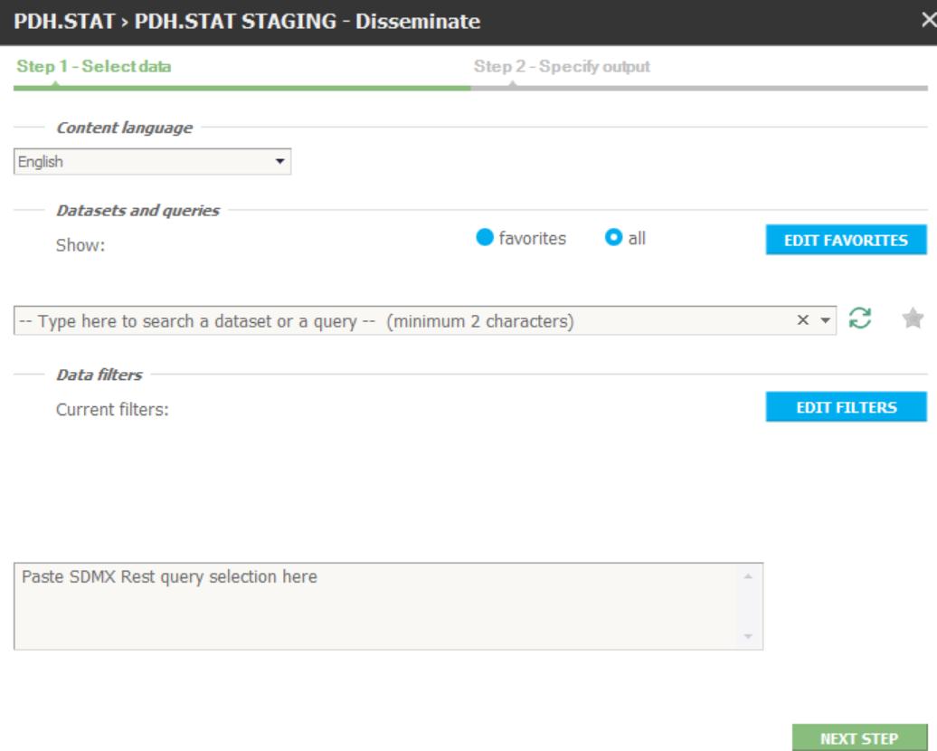
Get data: select
Step 2
Select Data flow

Slide 8
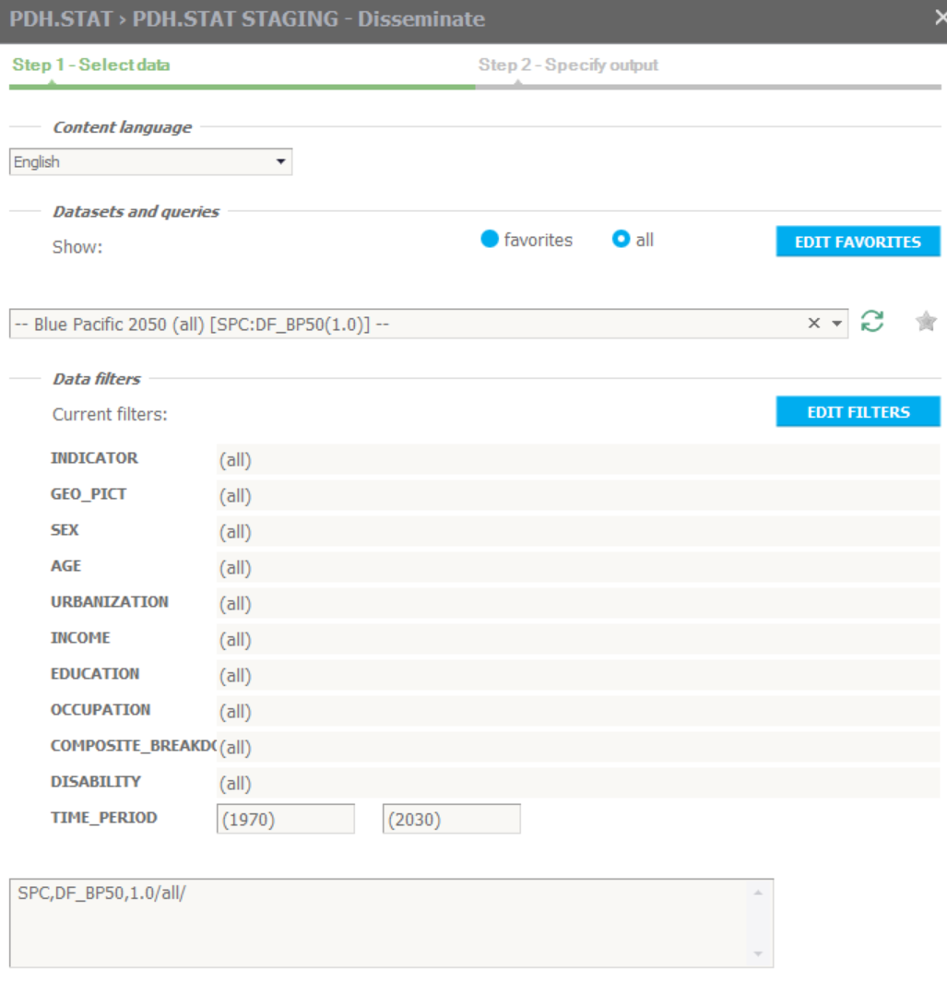
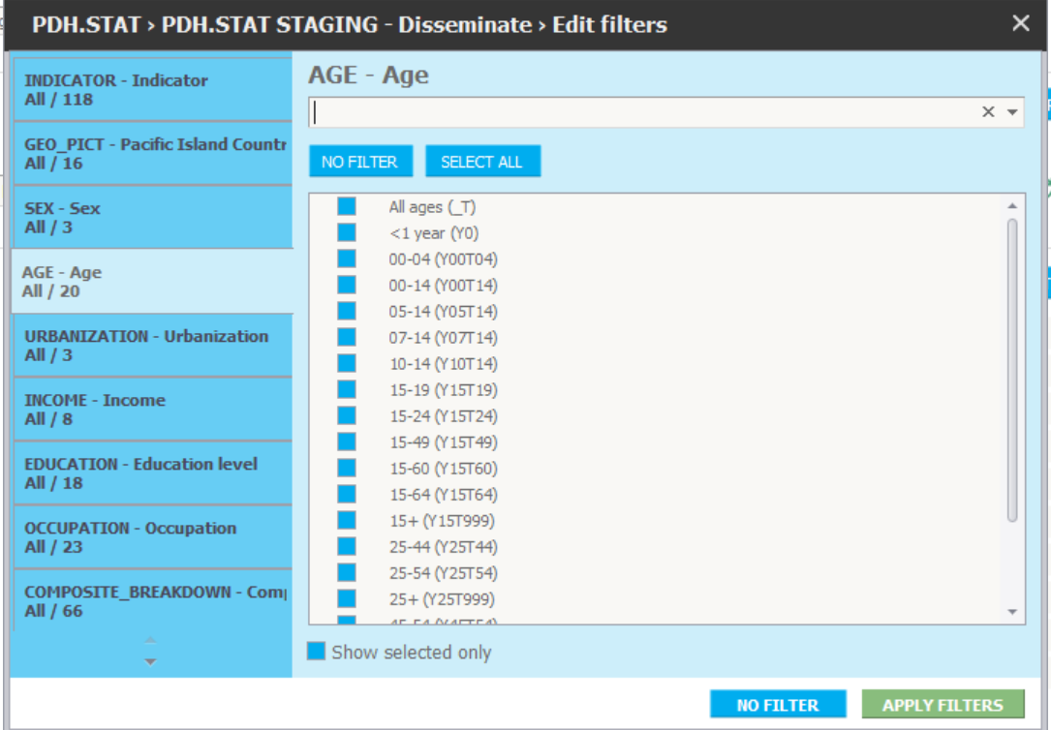
Get data: select
Step 3 (optional)
Filter Data flow

Slide 9
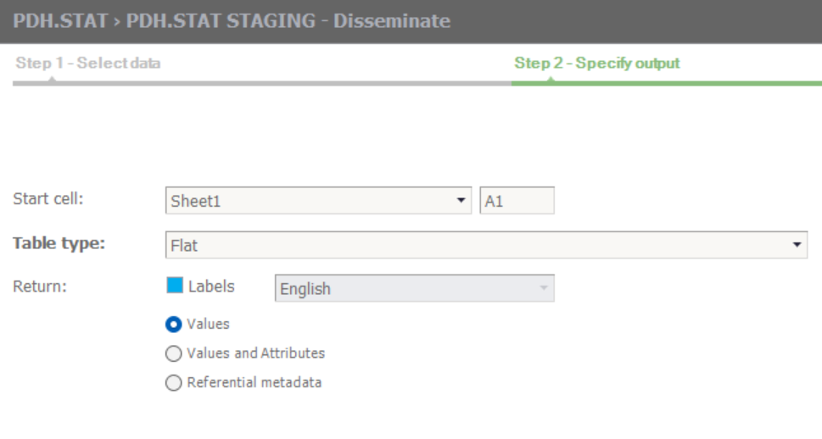
Get data: output
Step 4
Specify output Table type: flat, timeseries (down: as rows, across: as columns)
What: Values, Values and Attributes, Referential metadata

Slide 10
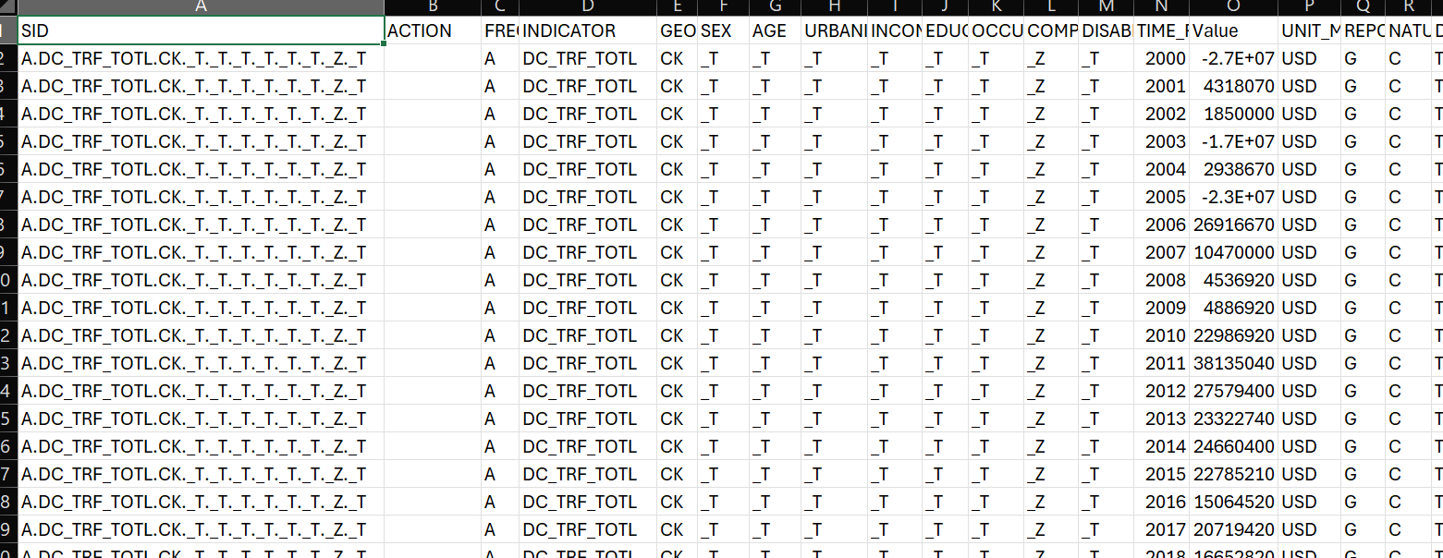
Get data: data content
observation and attributes values

Slide 11
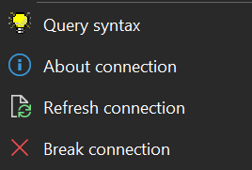
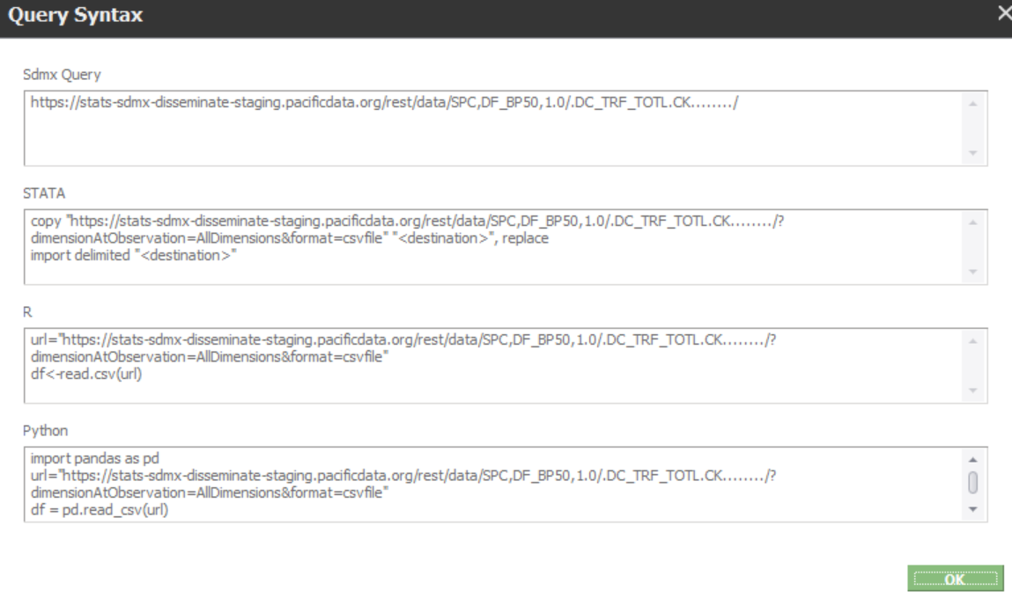
Get data: data content
Right click on data:
Excel-Addin generates user selection in various supported formats by clicking on “QUERY SYNTAX”:
SDMX Rest query
STATA
R
Python

Slide 12
Get data: data content
observation and attributes values
SID (stands for “Series Identifier”):
full coordinate (key) of each time series constructed as the combination of the IDs of the values of each dimension, except the Time Period dimension, separated with ‘.’
Mandatory for adding new observation or attribute values

Slide 13
Get data: data content
observation and attributes values
one column for the ID of each dataflow dimension

Slide 14
Get data: data content
observation and attributes values
OBS_VALUE column: the corresponding observation value (no value: empty)

Slide 15
Get data: data content
observation and attributes values
Attribute column: the corresponding attribute value (coded: ID, non-coded: value, no value: empty)

Slide 16
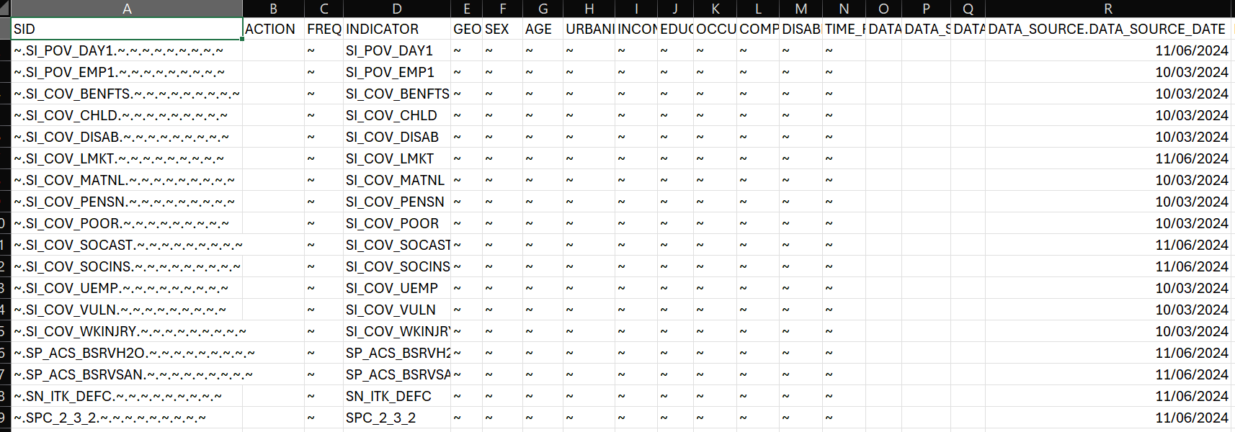
Get data: metadata content
SID (Series Identifier)
one column for the ID of each dataflow dimension
one column for the ID of each referential metadata attribute

Slide 17
Edit data
Action

Slide 18
Edit data
Action
can be Merge (default), Replace, Delete
‘Time series’ layouts always apply Merge

Slide 19
Edit data
Action
can be Merge (default), Replace, Delete
‘Time series’ layouts always apply Merge

Slide 20
Edit data: update/replace
Merge: will only update the (meta)data provided in the table. Related emptycells will not change the corresponding current value
Replace: will fully replace whole observations with their observation (measure) value and their attributes defined at observation level provided in the table. Related empty cells will delete the corresponding current value in the data space.
However, values of attributes attached at higher levels than observation will be Merged.

Slide 21
Edit data: delete
Delete: will delete the (meta)data values provided in the table. Related empty Excel cells will not change the current value, unless all data or reference metadata values in the row are left empty, which results in deleting the whole corresponding coordinate.
For referential metadata you can use wildcard deletions of ranges of reference metadata attached at a specific set of dimensions. This can be achieved by replacing in the Excel table the related dimension value(s) by the star character *.

Slide 22
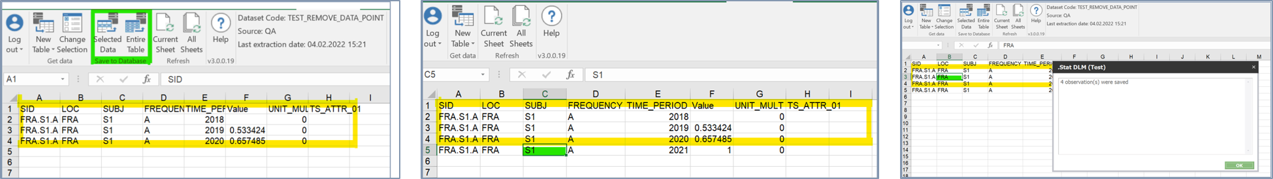
Edit data: add
New rows can be added at the end of the data or referential metadata table in order to add new data or referential metadata to the data space

Slide 23
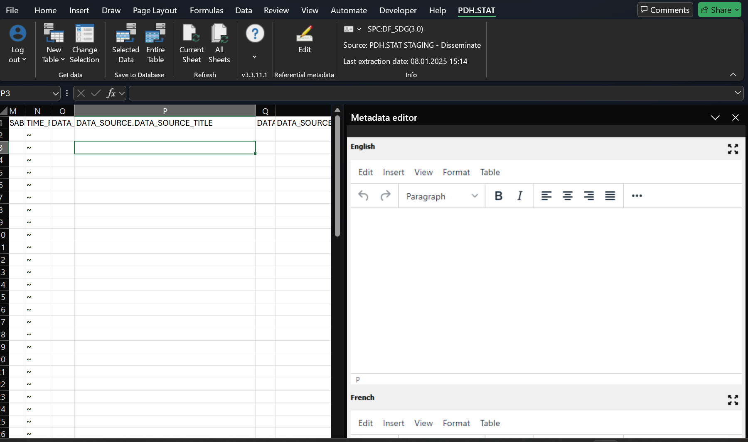
Edit data: edit
Available for columns in a referential metadata table of type “XHTML” or “String”

Slide 24
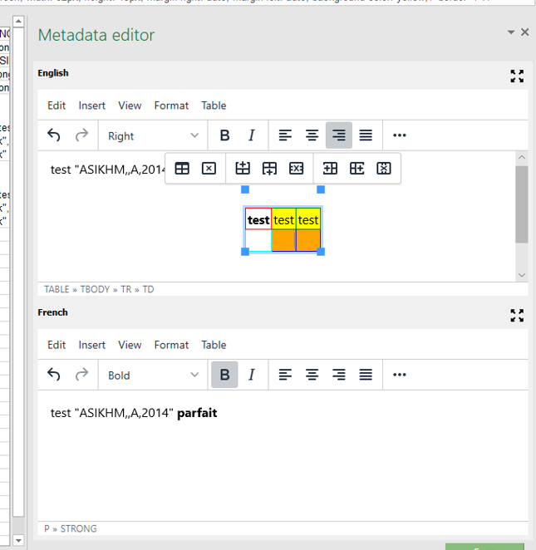
Edit data: edit
Available for columns in a referential metadata table of type “XHTML” or “String”
When “XHTML” (xml-compliant HTML), then the metadata editor provides a rich-text editor menu enabling (WYSIWYG) HTML editing

Slide 25
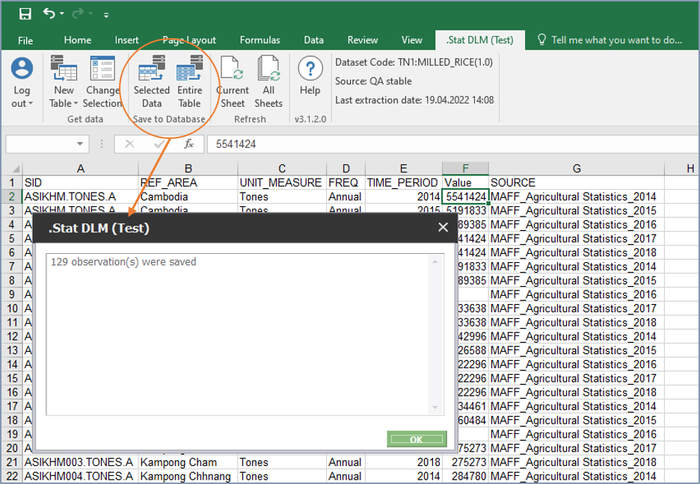
Edit data: save
select a range of edited data or referential metadata and save back only the current selection by clicking on “Selected data”, or
save all changes made on the current table by clicking on “Entire table”.

Slide 26
Discussion and Q&A

